Slide 1
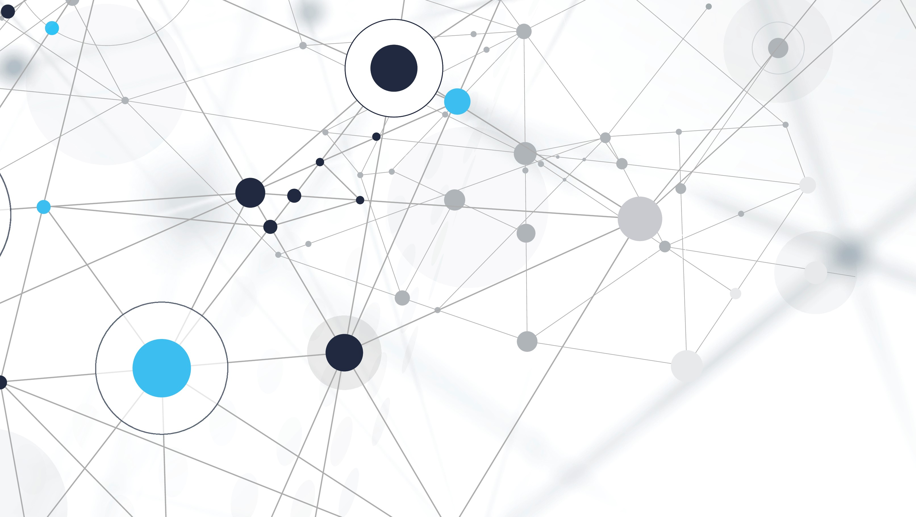
Ml . Algorithm .
Reesman

Slide 2
Machine Learning Algorithms in Supervised, Unsupervised models
Naive Bayes algorithm
Linear regression
Logistic regression
SVM algorithm
Decision tree
Random forest algorithm
KNN algorithm
K-means

Slide 3
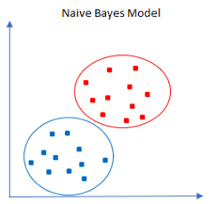
Naive Bayes algorithm
Naive Bayes algorithm
Linear regression
Logistic regression
SVM algorithm
Decision tree
Random forest algorithm
KNN algorithm
K-means
Naïve Bayes algorithm is a supervised learning algorithm, which is based on Bayes theorem and used for solving classification problems. It is mainly used in text classification that includes a high-dimensional training dataset.

Slide 4




spam
normal

Slide 5
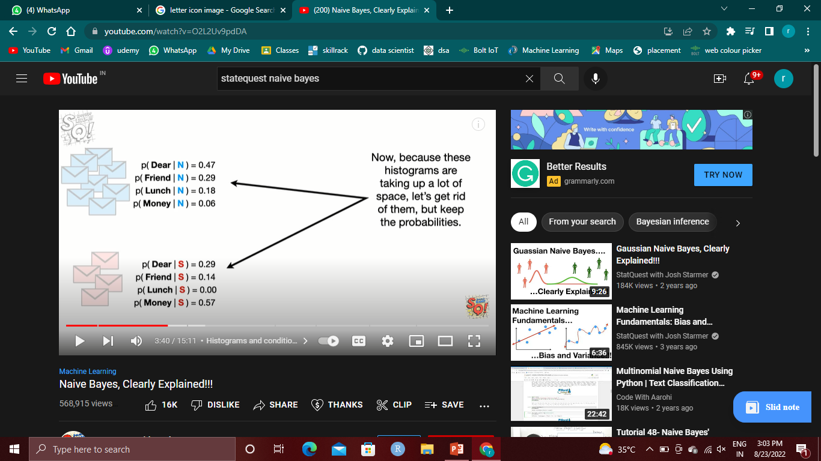
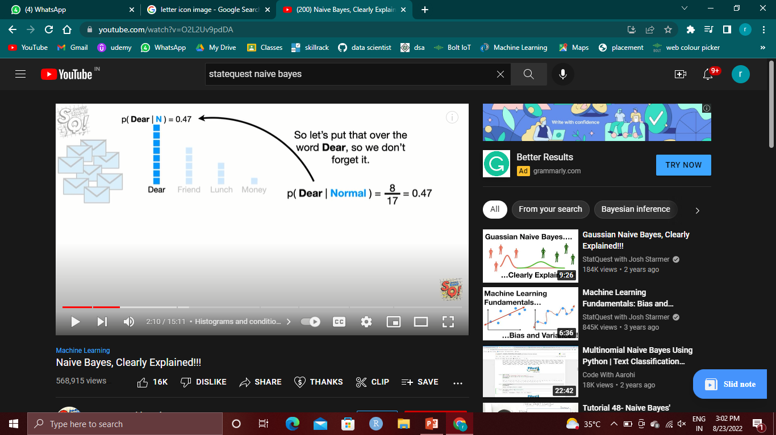

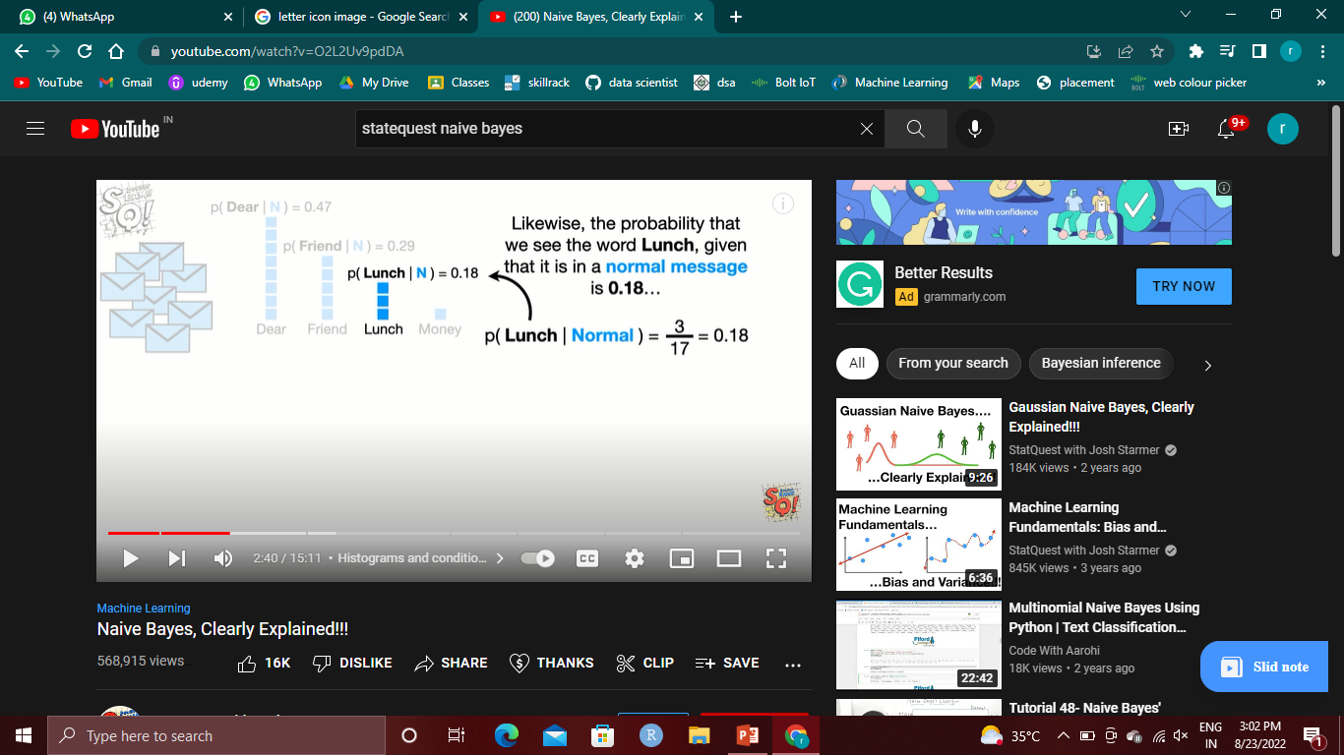
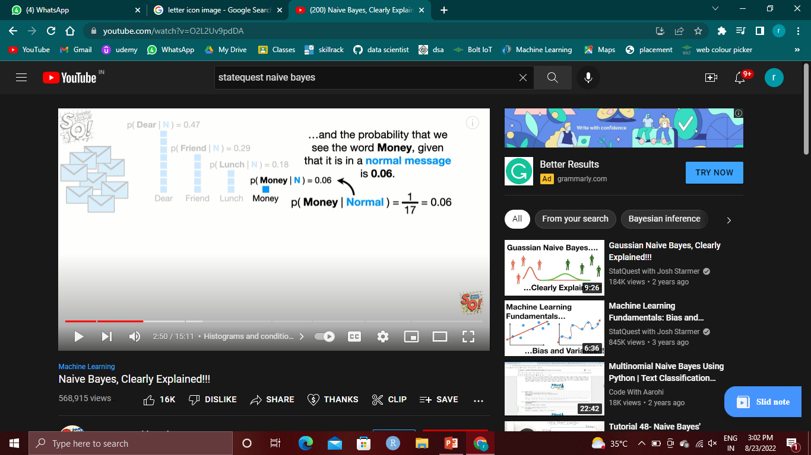

Slide 6
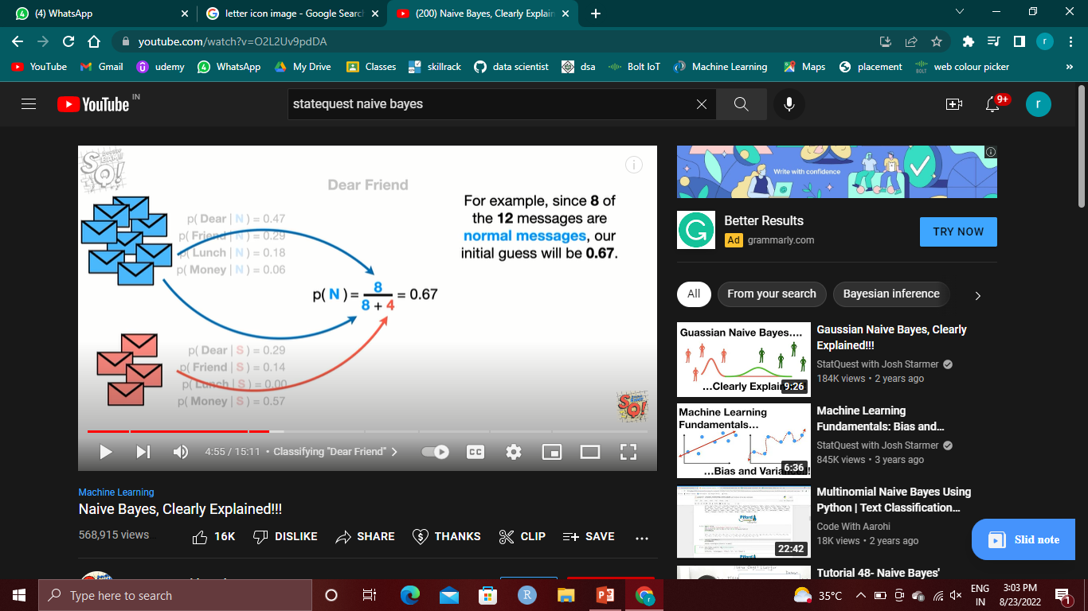
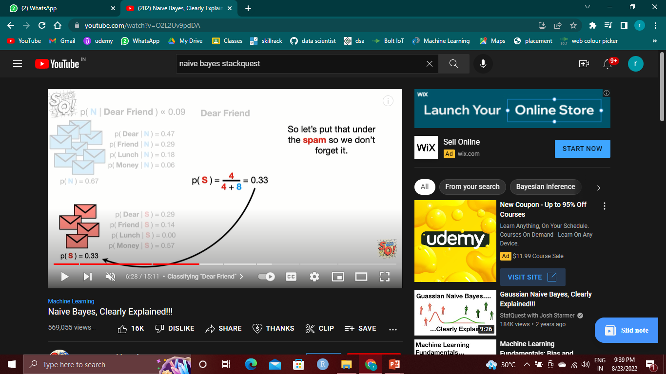




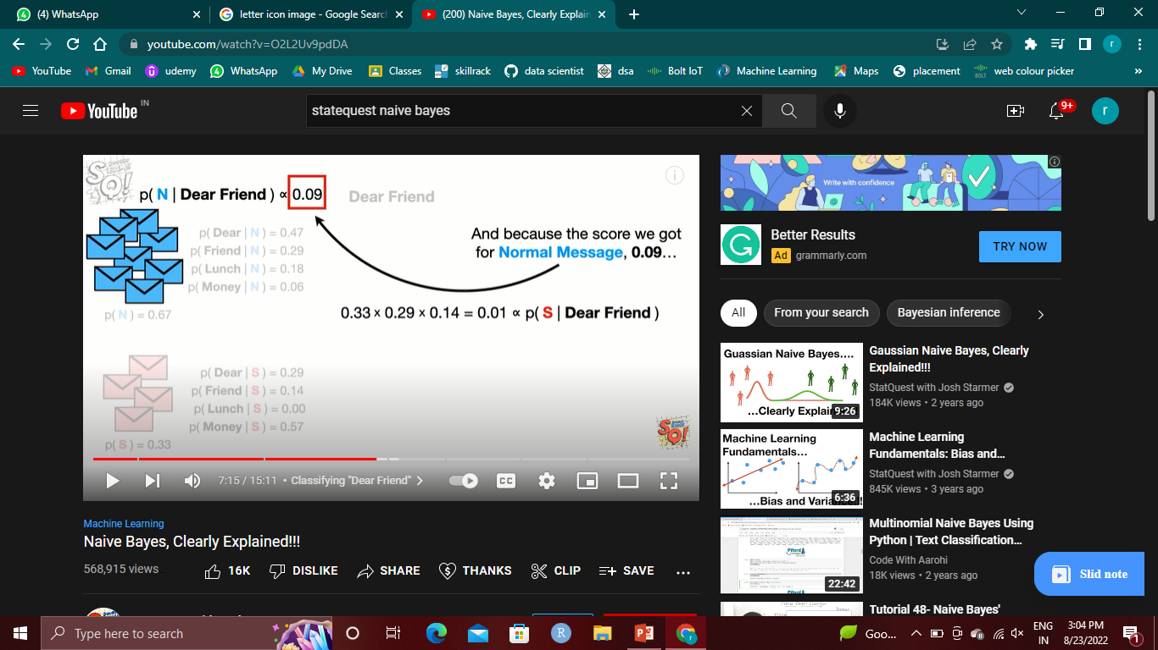
Dear friend

Slide 7



Lunch money money money money

Slide 8
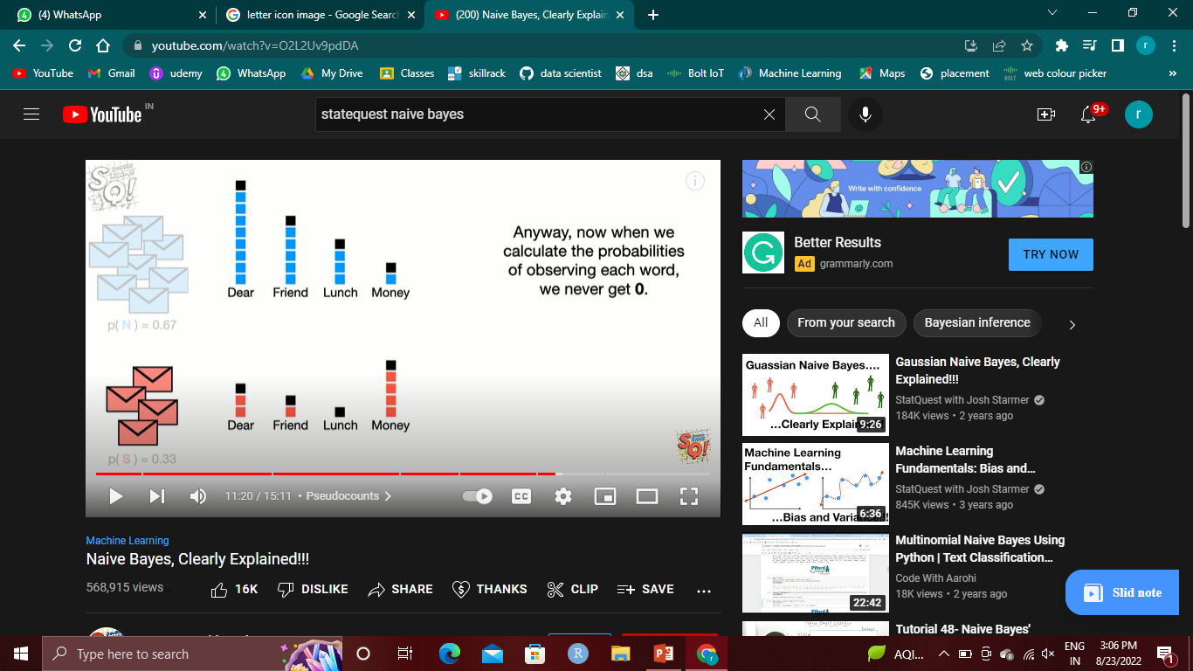
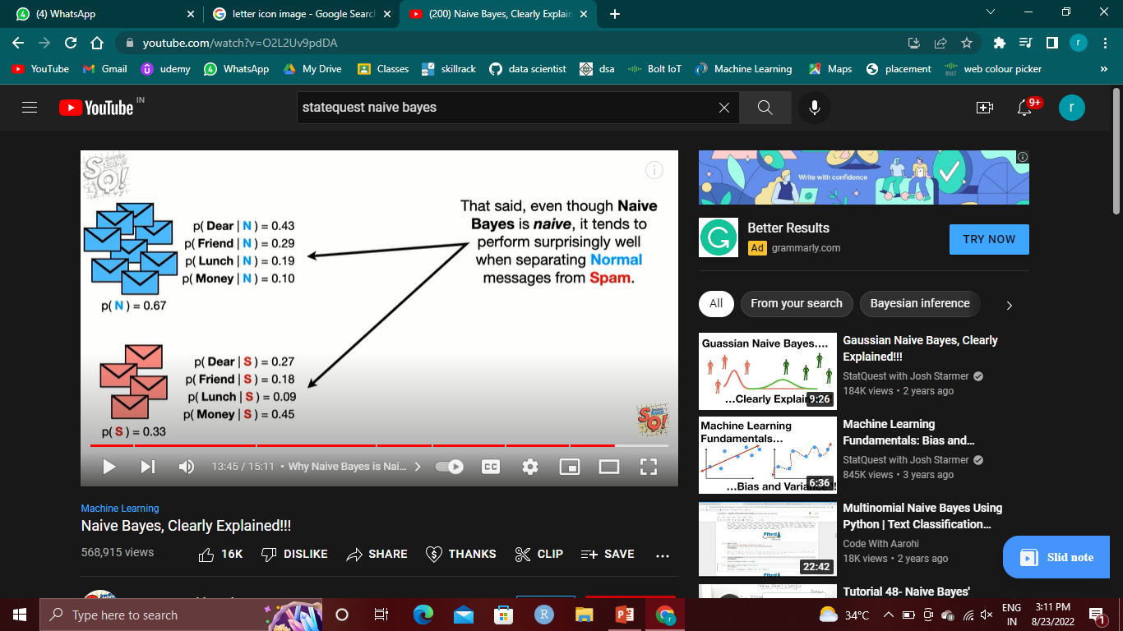

Lunch money money money money

Slide 9
Linear regression
Naive Bayes algorithm
Linear regression
Logistic regression
SVM algorithm
Decision tree
Random forest algorithm
KNN algorithm
K-means
a relationship is established between independent and dependent variables by fitting them to a line.
Y= a * X + b.
In this equation:
Y – Dependent Variable
a – Slope
X – Independent variable
b – Intercept

Slide 10
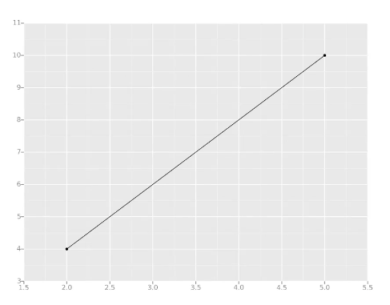
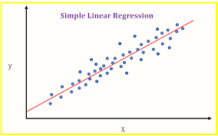
The coefficients a & b are derived by minimizing the sum of the squared difference of distance between data points and the regression line.
Naive Bayes algorithm
Linear regression
Logistic regression
Decision tree
SVM algorithm
KNN algorithm
K-means
Random forest algorithm

Slide 11
Logistic regression
Naive Bayes algorithm
Linear regression
Logistic regression
SVM algorithm
Decision tree
Random forest algorithm
KNN algorithm
K-means
is used to estimate discrete values (usually binary values like 0/1) from a set of independent variables. It helps predict the probability of an event by fitting data to a logit function. It is also called logit regression.

Slide 12
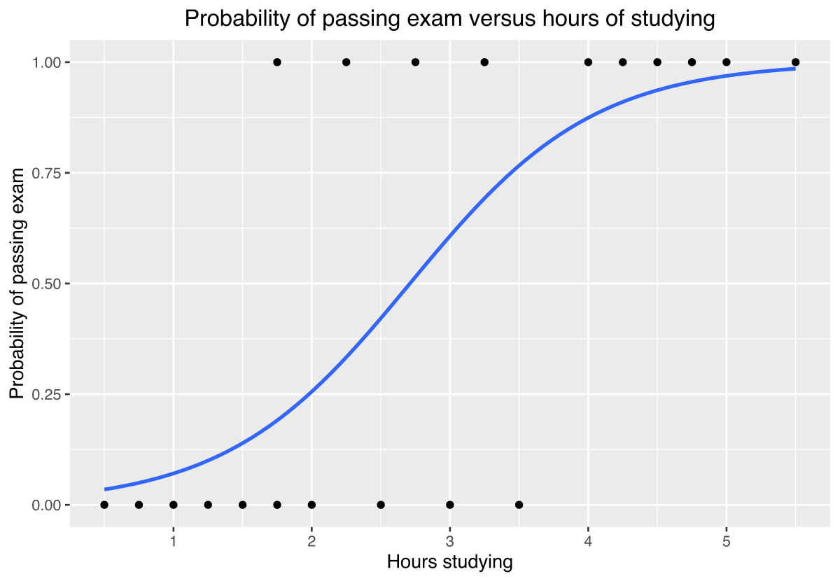
Naive Bayes algorithm
Linear regression
Logistic regression
Decision tree
SVM algorithm
KNN algorithm
K-means
Random forest algorithm

Slide 13
summary
Naive Bayes algorithm
Linear regression
Logistic regression
SVM algorithm
Decision tree
Random forest algorithm
KNN algorithm
K-means
Linear
arranged in or extending along a straight or nearly straight line.
Regression
trend or shift toward a lower or less perfect state
Logistic
the detailed organization and implementation of a complex operation.
Linear regression least square method
Logistic true or false method

Slide 14
Support vector machines
Naive Bayes algorithm
Linear regression
Logistic regression
SVM algorithm
Decision tree
Random forest algorithm
KNN algorithm
K-means
SVM or Support Vector Machine is a supervised machine learning algorithm,
It’s a linear model for classification and regression problems.
The idea of SVM is simple:
The algorithm creates a line or a hyperplane which separates the data into classes.

Slide 15
Support vector classifier

Slide 17
drugs
Support vector machines

Slide 19
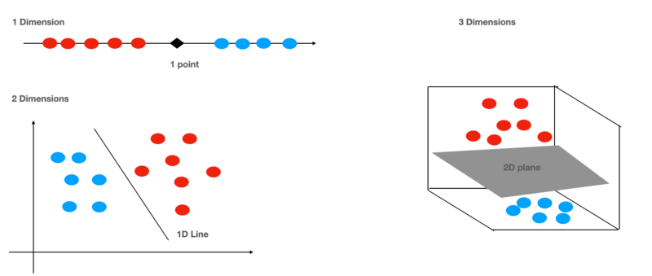

Slide 20
Decision tree
Naive Bayes algorithm
Linear regression
Logistic regression
SVM algorithm
Decision tree
Random forest algorithm
KNN algorithm
K-means
A decision tree is a non-parametric
supervised learning algorithm,
which is utilized for both classification and regression tasks.
It has a hierarchical, tree structure, which consists of a root node, branches, internal nodes and leaf nodes.

Slide 21
Will you accept him or not?
Age<25
yes no
handsome sumaar
Yes no yes no
accept reject accept reject

Slide 22
Random forest
Naive Bayes algorithm
Linear regression
Logistic regression
SVM algorithm
Decision tree
Random forest algorithm
KNN algorithm
K-means
The random forest is a classification algorithm
It consisting of many decisions trees
It uses bagging and feature randomness when building each individual tree
Tries to create an uncorrelated forest of trees whose prediction by committee is more accurate than that of any individual tree.

Slide 23
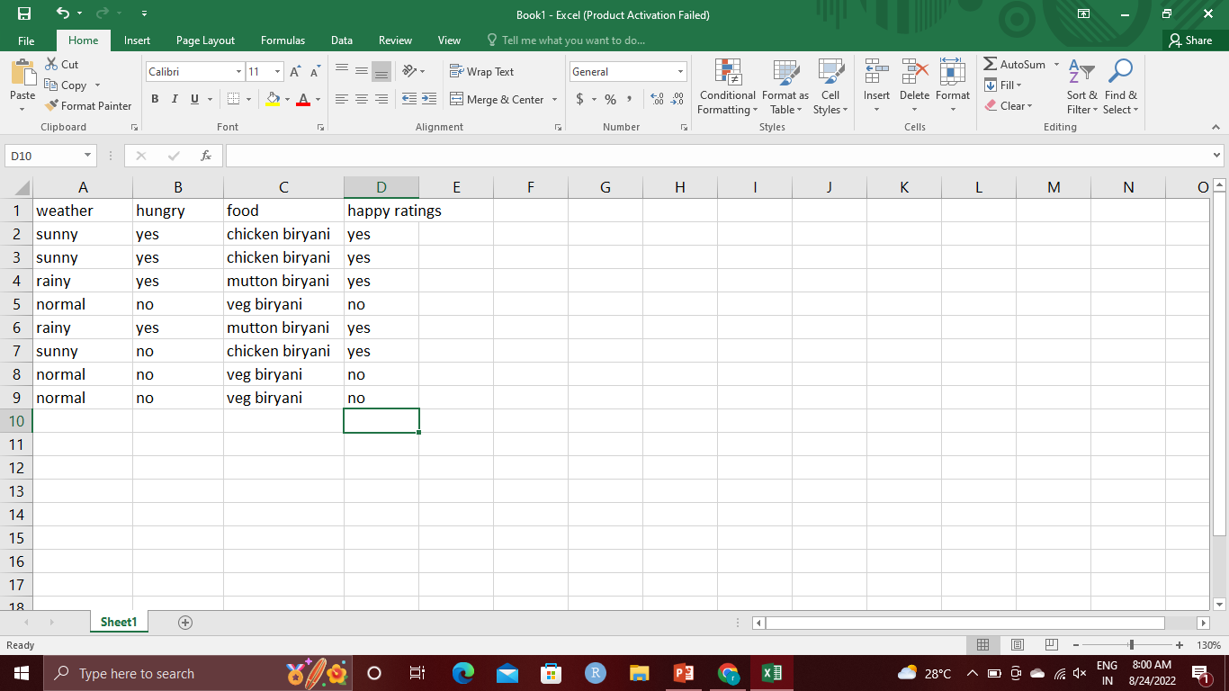
Bootstrapped data set
Randomly selected
Repitition allowed
Weather
Sunny rainy normal
Hungry not hungry
yes no yes no
Non-veg veg Non-veg veg
yes

Slide 24
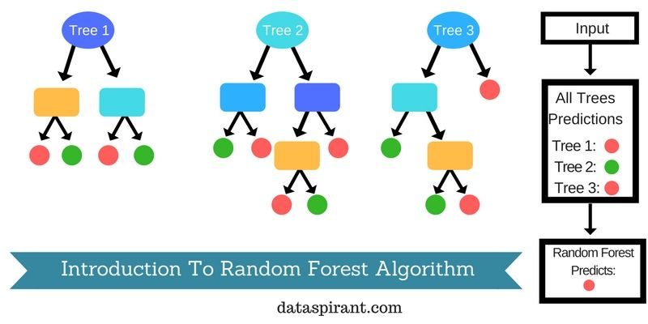
Majority voting

Slide 25
K nearest neighbors
Naive Bayes algorithm
Linear regression
Logistic regression
SVM algorithm
Decision tree
Random forest algorithm
KNN algorithm
K-means
The k-nearest neighbors (KNN) algorithm is a simple, supervised machine learning algorithm that can be used to solve both classification and regression problems.
knn is an approach to data classification that estimates how likely a data point is to be a member of one group or the other depending on what group the data points nearest to it are in.

Slide 26
K = 5
pink

Slide 27
K-means
Naive Bayes algorithm
Linear regression
Logistic regression
SVM algorithm
Decision tree
Random forest algorithm
KNN algorithm
K-means
K-Means Clustering is an unsupervised learning algorithm that is used to solve the clustering problems in machine learning or data science
Kmeans algorithm is an iterative algorithm that tries to partition the dataset into Kpre-defined distinct non-overlapping subgroups (clusters) where each data point belongs to only one group.

Slide 28
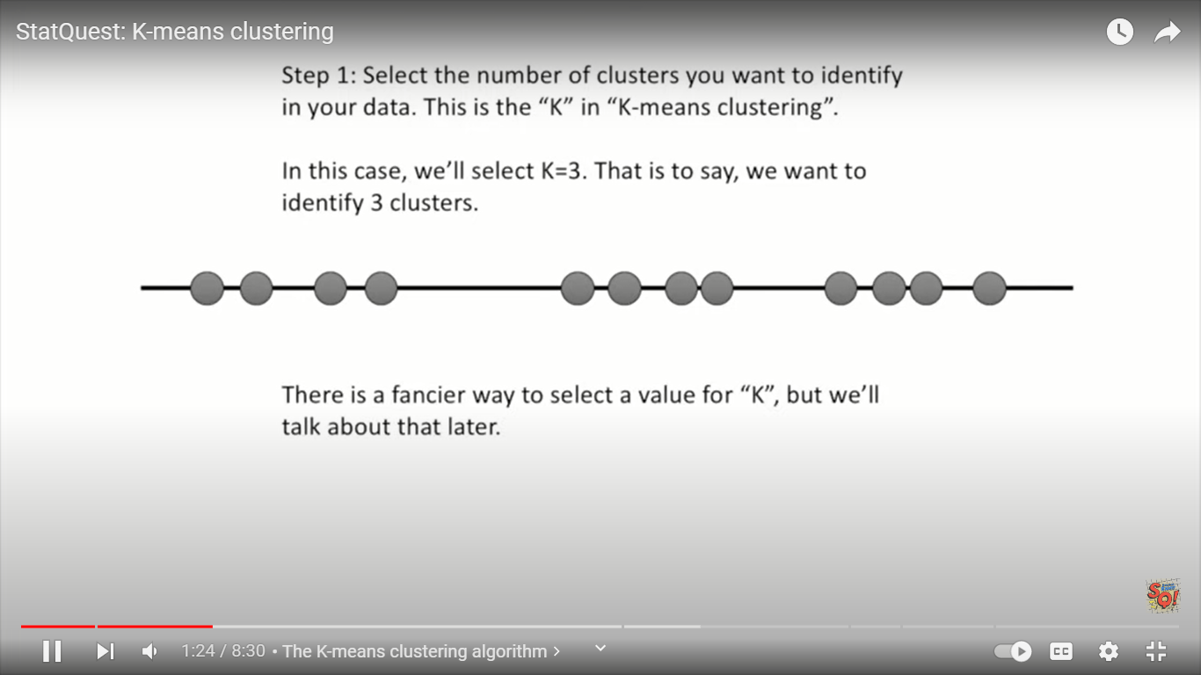
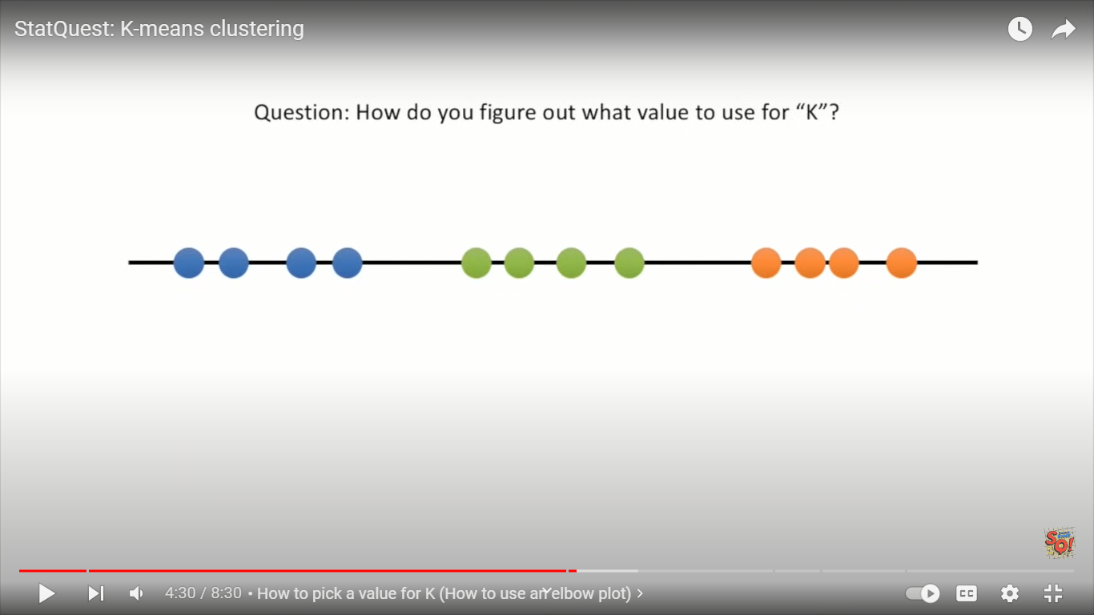
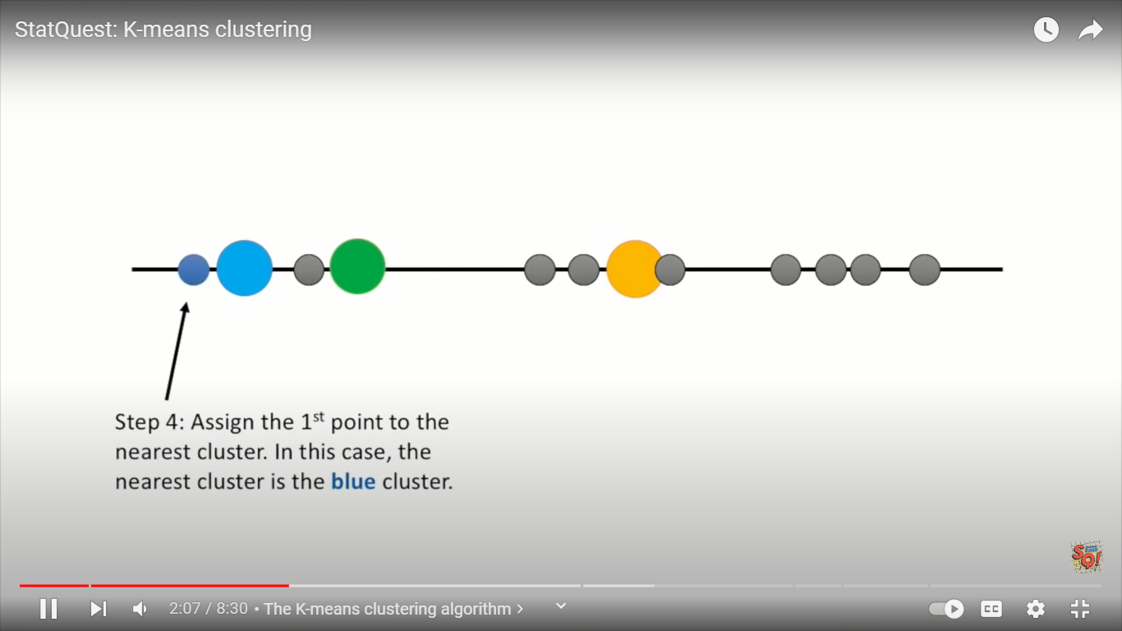
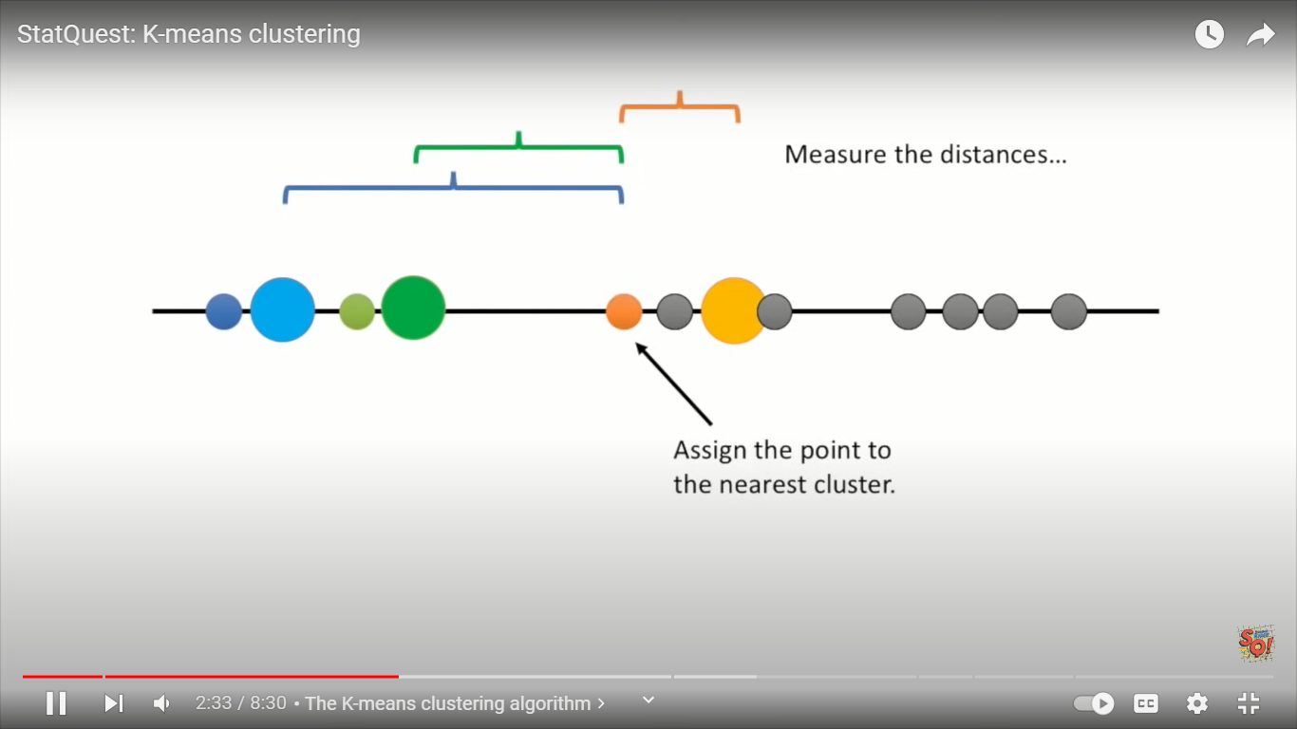
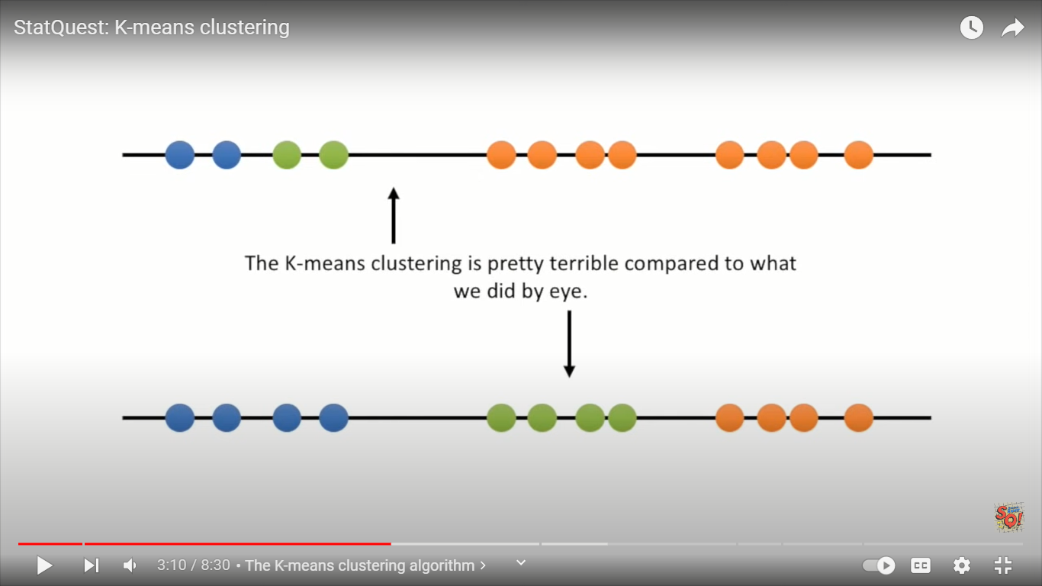
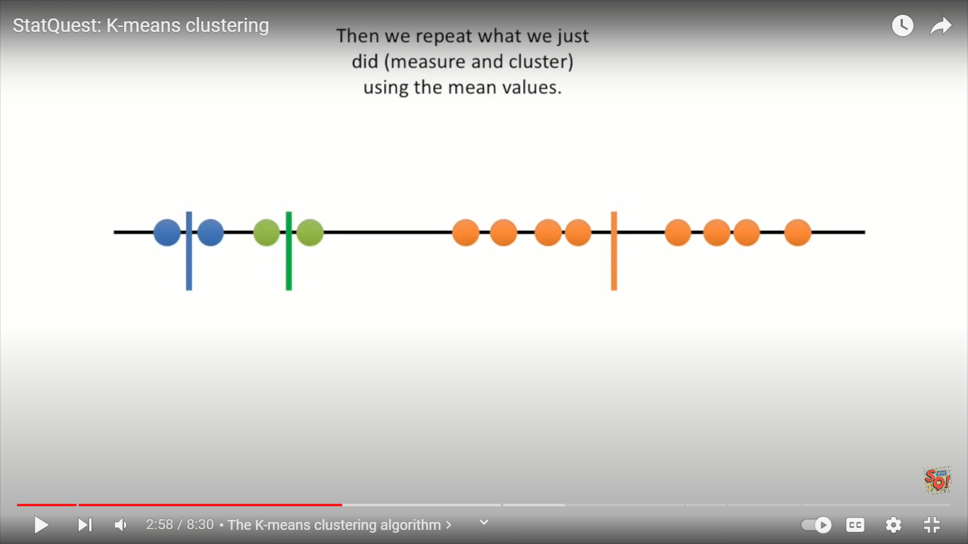

Slide 29
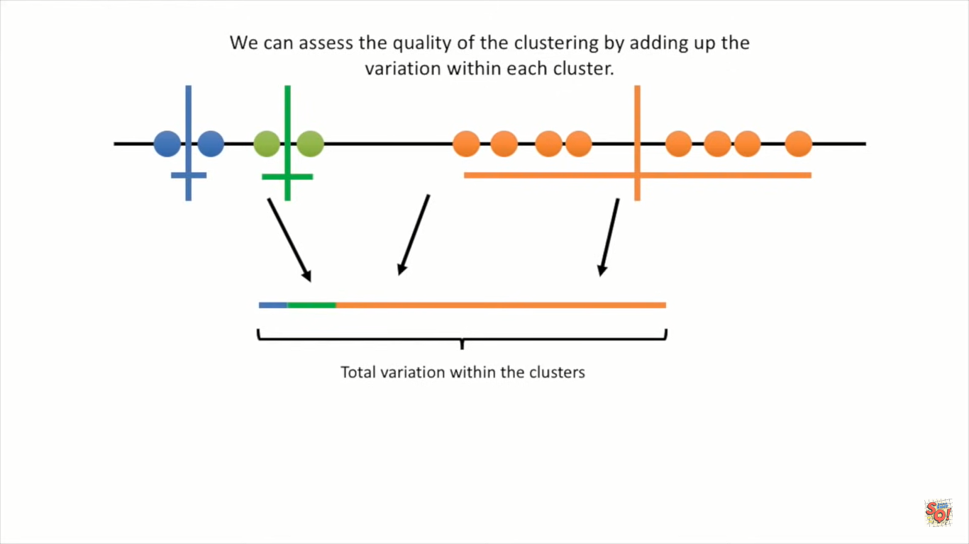
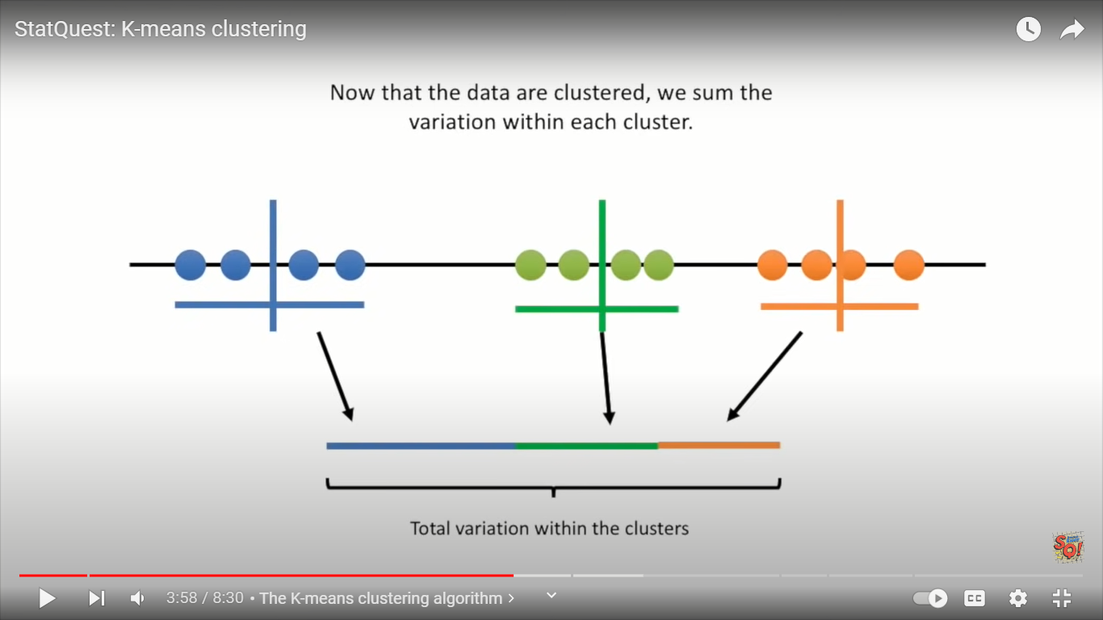
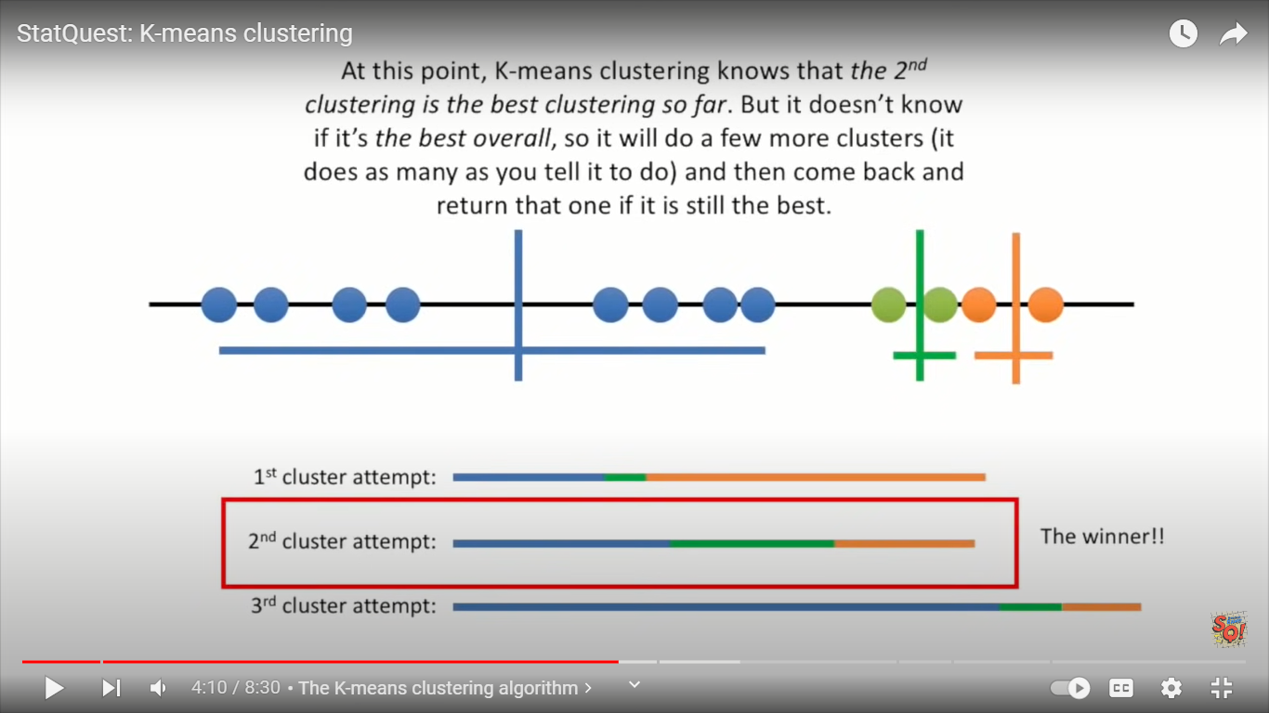

Slide 30
